Slide 1
Game Architecture
Collision Detection
Making things interact.

Slide 2
What is collision detection?
Geometric Intersection
Pairwise reduction
Collision resolution

Slide 3
What is collision detection?
Geometric Intersection
Pairwise reduction
Collision resolution

Slide 4
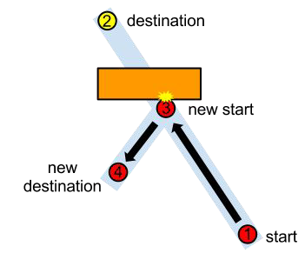
What is collision detection?
Geometric Intersection
Pairwise reduction
Collision resolution

Slide 5
Intersection Testing
General goals: given two objects with current and previous transforms specified, determine if, where, and when the two objects intersect
Alternative: given two objects with only current transforms, determine if they intersect
Sometimes, we need to find all intersections.
Other times, we just want the first one.
Sometimes, we just need to know if the two objects intersect and don’t need the actual intersection data

Slide 6
Case Reduction
Phases (Havok)
System operates in multiple phases of different granularities:
Broad phase
  Simplistic, large bounding shapes for fast rejection.
Mid phase
  Further refined bounding shapes
Narrow phase
  Close convex hull intersection, such as GJK

Slide 7
Case Reduction
Space Partitioning (UE4)
In lieu of a broad phase, a system may instead opt for a space partitioning system to bucket objects into different subspaces.
  Divide world space into partitions
    Octrees or BSP
  Bucket objects into partitions
  Perform tests within partitions.

Slide 8
Case Reduction
Filtering (everyone)
Objects only need to intersect with certain other objects
  Assignable collider types
  Layers (Bitmasks)

Slide 9
Geometric Intersection
Intersection testing is costly
  Triangle-to-triangle test several times costlier than circle-to-circle
  Thousands of triangles means thousands of times the cost
Approximate bounds with simpler shapes
There are trade-offs
  Accuracy
  Complexity

Slide 10
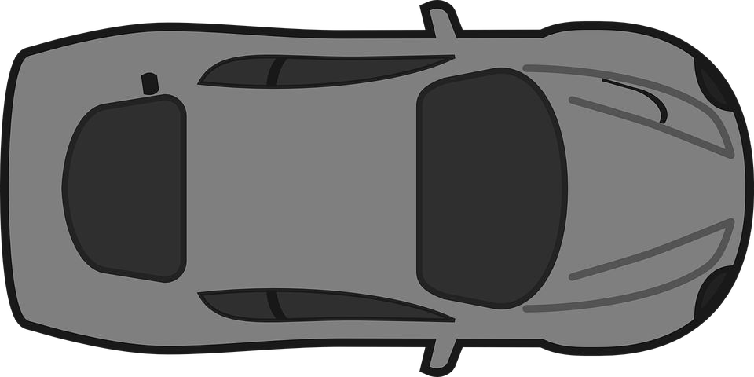
Shapes: Sphere
|C₁ - C₂| < r₁ + r₂

Slide 11
Capsule
Cylinder with hemispheres on ends
One way to compute:
  Calc bounding box
  Use long axis for length
  Next largest width for radius
r
r

Slide 12
Shapes: Capsule
dist(L₁, L₂) < r₁ + r₂

Slide 13

Line-Line Distance
where x0 and x1 are points on respective lines, and n0 and n1 are unit direction vectors along those lines

Slide 14
Segment-Segment Collision
Determine closest point between lines
If lies on both segments, done
Otherwise clamp against nearest endpoint and recompute
Notes:
wikipedia says to use a sweep algorithm

Slide 15
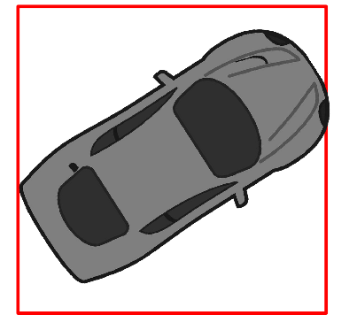
Shapes: AABB
C₁.x - C₂.x < w₁ + w₂
and
C₁.y - C₂.y < h₁ + h₂
and
C₁.z - C₂.z < l₁ + l₂
y
x

Slide 16
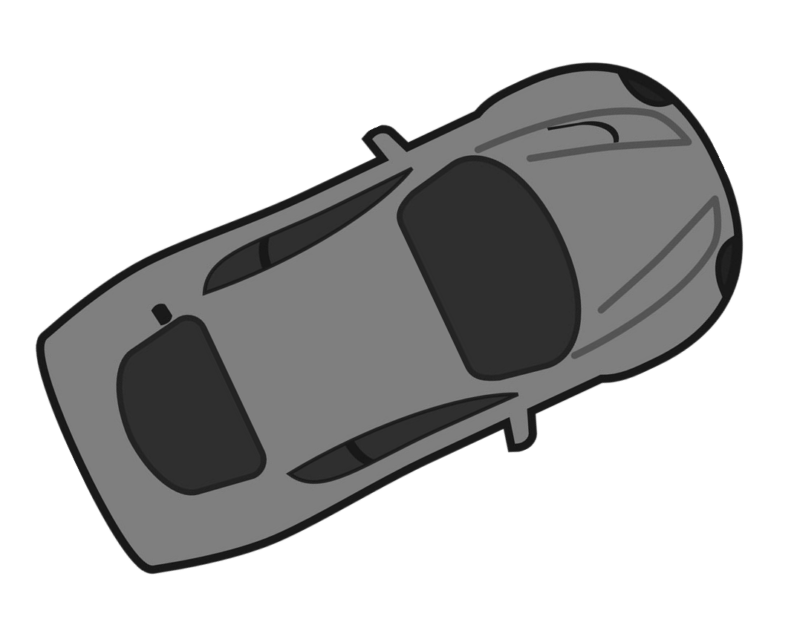
Shapes: OOBB
???
y
x

Slide 17
Separating Axis Theorem
For two convex shapes, if an axis exists on which the projections of both shapes do not overlap, the objects are not intersecting.

Slide 18
Two objects do not collide
if
there exists a plane that separates them.

Slide 19
AABB Collision
Compare x values in min,max vertices
If min2 > max1 or min1 > max2, no collision (separating plane)
Otherwise check y and z directions
min₁
max₁
min₂
max₂

Slide 20


Projection for OOBB
Sum the projection of the half vectors to get the ‘radius.’
Project a onto b:
y
When b is a unit vector:
x

Slide 21
Projection for OOBB
Double the projection and center it on the box’s position along the axis.
  In practice, the ‘center point’ is the center of the box dotted with the axis.
Check for overlap of projections along that axis.
Repeat for each axis.
Reject on first non-overlap.
y
x

Slide 22
Separating Axis Theorem
Can be extended to any other convex shape
Project all vertices onto the axis
(v dot a) is the magnitude of the projection
Use this for min/max comparison

Slide 23
Separating Axis Theorem
http://www.metanetsoftware.com/technique/tutorialA.html
Notes:
go there

Slide 24
Gilbert-Johnson-Keerthi Distance Algorithm (GJK)
http://vec3.ca/gjk/
http://realtimecollisiondetection.net/pubs/SIGGRAPH04_Ericson_the_GJK_algorithm.ppt

Slide 25


Minkowski Sum
The Minkowski sum is the result of taking every point within one shape, and adding it to every point in another.
the difference is simply the subtraction of B from A.
If a point (x,y) is in both A and B, then the point (0,0) will be one of the points in the Minkowski sum of A-B.

Slide 26
At a High Level
The Minkowski difference (M) of two convex shapes is itself convex, and...
The Minkowski difference of two intersecting convex shapes contains the origin.
  This is mostly intuitive - if the shapes are intersection, they share some of the same points.
  Those points subtracted from themselves equals the origin.
The GJK algorithm seeks to locate the origin within the Minkowski difference of two convex shapes.
  It does so by constructing a simplex (in 3D, a tetrahedron) within the difference which contains the origin.

Slide 27
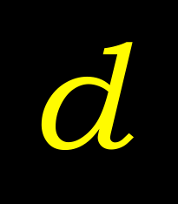


Gilbert-Johnson-Keerthi Distance Algorithm (GJK)
Given two convex polyhedra
  Computes distance d
  Can also return closest pair of points P_{A}, P_{B}

Slide 28
Generalized for arbitrary convex objects
  As long as they can be described in terms of a support mapping function
Notes:
a support mapping function returns a plane tangent to a point (plane divides space so that the object is completely in one of the half-spaces, and there’s one point on the plane)

Slide 29
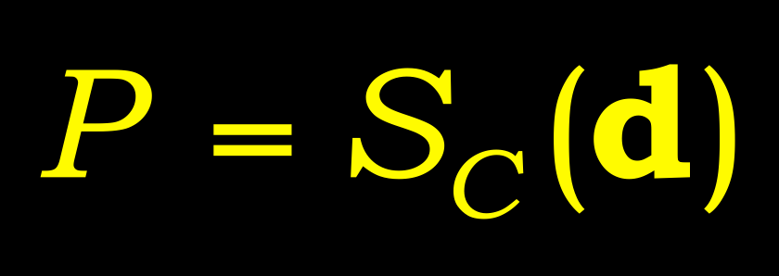





Supporting (or extreme) point
for direction
returned by support mapping function
Notes:
Supporting points are not necessarily unique. That is, there may be infinitely many supporting points for a given direction. The support mapping function for a convex polyhedron simply returns the vertex most distant in direction d (any one if several equally distant). The support mapping for a sphere C of radius r and center O is given by S_{C}(d) = O + r * ||d||.

Slide 30
0-simplex
1-simplex
2-simplex
3-simplex
simplex
Notes:
A d-simplex is the convex hull of d+1 affinely independent points in d-dimensional space. A simplex (plural simplices) is a d-simplex, for some given d.

Slide 31
Point set C
Convex hull, CH(C)
Notes:
The convex hull of a set C of points is here denoted by CH(C).

Slide 32
The GJK algorithm
Initialize the simplex set Q with up to d+1 points from C (in d dimensions)
Compute point P of minimum norm in CH(Q)
If P is the origin, exit; return 0
Reduce Q to the smallest subset Q’ of Q, such that P in CH(Q’)
Let V=S_{C}(–P) be a supporting point in direction –P
If V no more extreme in direction –P than P itself, exit; return ||P||
Add V to Q. Go to step 2
Notes:
2) “Point of minimum norm” is a snooty way of saying “point closest to the origin”.

Slide 33
GJK example
INPUT: Convex polyhedron C given as the convex hull of a set of points
Notes:
The example here uses a convex polyhedron, but the same principle applies to any convex object.

Slide 34




GJK example
Initialize the simplex set Q with up to d+1 points from C (in d dimensions)
Notes:
Here we initialize Q with three points simply to reduce the number of steps required for the algorithm to terminate (to keep the example short).

Slide 35





GJK example 3(10)
Compute point P of minimum norm in CH(Q)
Notes:
Exactly how the point of minimum norm in CH(Q) is found is described further ahead.

Slide 36

GJK example 4(10)
If P is the origin, exit; return 0
Reduce Q to the smallest subset Q’ of Q, such that P in CH(Q’)
Notes:
Only Q₁ and Q₂ are needed to express P as a convex combination of points in Q. Q₀ is therefore deleted from Q. A convex combination is a weighted linear combination of the points, all weights being non-negative. (Compare barycentric coordinates.)

Slide 37

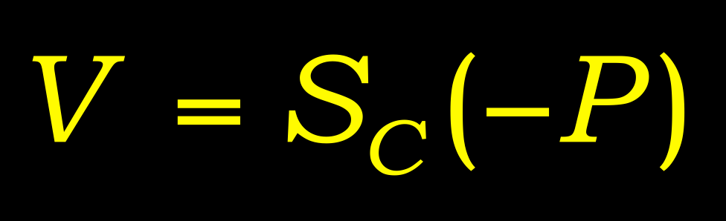
GJK example 5(10)
Let V=S_{C}(–P) be a supporting point in direction –P
Notes:
The indicated yellow point V is the supporting point in direction –P.

Slide 38


GJK example 6(10)
If V no more extreme in direction –P than P itself, exit; return ||P||
Add V to Q. Go to step 2

Slide 39

GJK example 7(10)
Compute point P of minimum norm in CH(Q)

Slide 40

GJK example 8(10)
If P is the origin, exit; return 0
Reduce Q to the smallest subset Q’ of Q, such that P in CH(Q’)

Slide 41

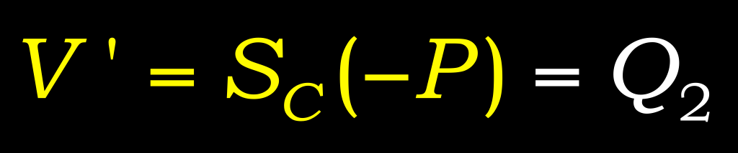
GJK example 9(10)
Let V=S_{C}(–P) be a supporting point in direction –P
Notes:
Here there are infinitely many supporting points in direction –P. We arbitrarily picked Q₂.

Slide 42

GJK example 10(10)
If V no more extreme in direction –P than P itself, exit; return ||P||
DONE!
Notes:
Q₂ is no more extreme than P in direction –P, so the algorithm terminates. P is the point on C closest to the origin.

Slide 43
Distance subalgorithm 1(2)
Approach #1: Solve algebraically
  Used in original GJK paper
  Johnson’s distance subalgorithm
    Searches all simplex subsets
    Solves system of linear equations for each subset
    Recursive formulation
    From era when math operations were expensive
    Robustness problems
  See e.g. Gino van den Bergen’s book

Slide 44
Distance subalgorithm 2(2)
Approach #2: Solve geometrically
  Mathematically equivalent
    But more intuitive
    Therefore easier to make robust
  Use straightforward primitives:
    ClosestPointOnEdgeToPoint()
    ClosestPointOnTriangleToPoint()
    ClosestPointOnTetrahedronToPoint()
  Second function outlined here
    The approach generalizes

Slide 45




Closest point on triangle
ClosestPointOnTriangleToPoint()
Finds point on triangle closest to a given point

Slide 46





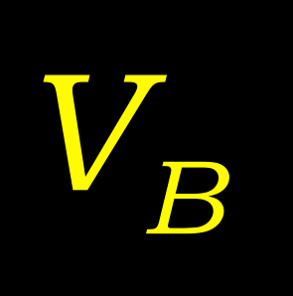

Closest point on triangle
Separate cases based on which feature Voronoi region point lies in
Notes:
A triangle has 7 feature Vornoi regions: 3 vertex regions, 3 edge regions, and 1 face region.

Slide 47


Closest point on triangle
Notes:
If the point lies in a vertex region, the closest point on the triangle is that vertex. The vertex regions are all tested in a similar manner.

Slide 48

Closest point on triangle
Notes:
If the point lies in an edge region, the closest point on the triangle is the orthogonal projection of the point onto the edge. If neither vertex nor edge regions contain the point, the closest point must lie inside the triangle (in the face region).

Slide 49
Appendix
The appendix is meant to cover other common geometric intersection and utility tests and their derivations.

Slide 50
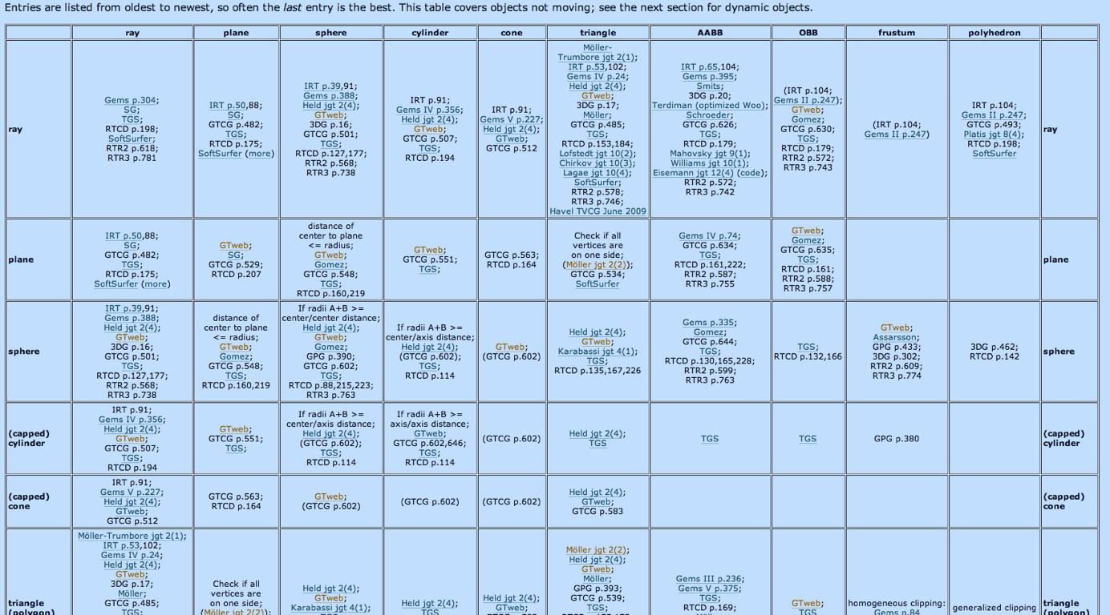
http://www.realtimerendering.com/intersections.html

Slide 51

Point-Line Distance
Given a point, P, and two points on the line, L₀ and L₁:
This works because the cross product’s magnitude depends on the angle between the two vectors.
  A point on the line will yield a cross product of zero magnitude for the numerator.

Slide 52


Point-Plane Distance
Given a point p and a plane defined by point p₀ and normal n:
Take a vector from the point on the plane to the point in space, and project it onto the plane’s normal. The magnitude of the project vector is the distance.
This can be simplified to:

Slide 53

Line-Line Distance
Given points p₀ and p₁ on respective lines with unit direction vectors u₀ and
u₁:
If the distance is 0, the lines are intersecting.

Slide 54

Ray-Plane Intersection
Given a ray defined by point p_{r} and direction r, and a plane defined by point
p₀ and normal n, we can find the point of intersection:
Basically use point-to-plane distance and dot product’s cosine equation to derive the equation.
If the scalar we scale r by is negative, the ray does not intersect the plane.

Slide 55
Ray-Triangle Intersection
Use ray-plane intersection to find the intersection point with the plane the triangle lies on.
Then, calculate the barycentric coordinates of the point in the triangle.
If the point lies in the triangle, there is an intersection between the ray and the triangle.

